Slide 1
CHAPTER-6
Arithmetic Unit

Slide 2
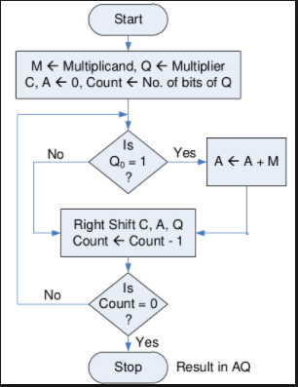
Shift-add multiplication: => multiplication of unsigned numbers. => multiplication can be performed by repeated addition of multiplicand and shifting

Slide 3
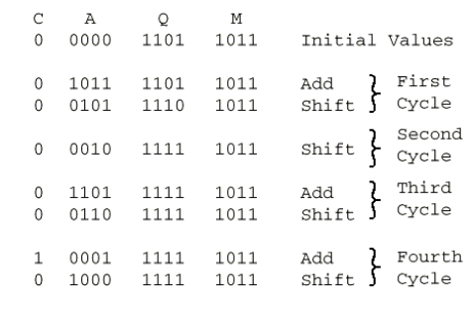
Contd…

Slide 4
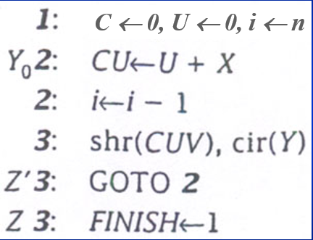
RTL code for shift-add multiplication

Slide 5
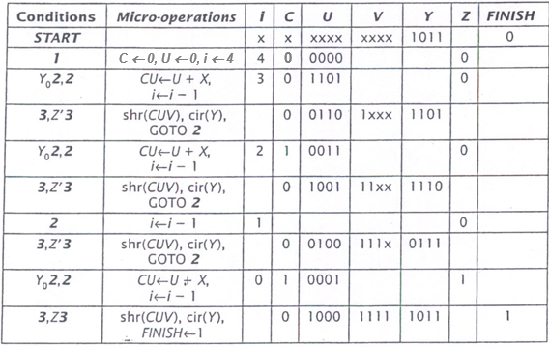
Contd… Example UV <- X x Y; X= 1101 and Y=1011.

Slide 6
Booth Algorithm
It reduces the number of addition.
Negative multiplier, positive multiplier are treated the same.
For negative numbers multiplication, the operation is performed by representing the negative numbers in it’s 2’s complement form.
ADVANTAGES: =>When there are lot of ones, all will be cancelled and replaced with zeros. => More zeros means, it reduces the addition(no operation is done with zeros) => But shift remains the same, can’t be reduced.

Slide 7
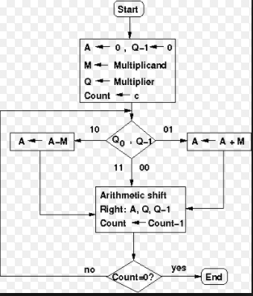
Contd…

Slide 8
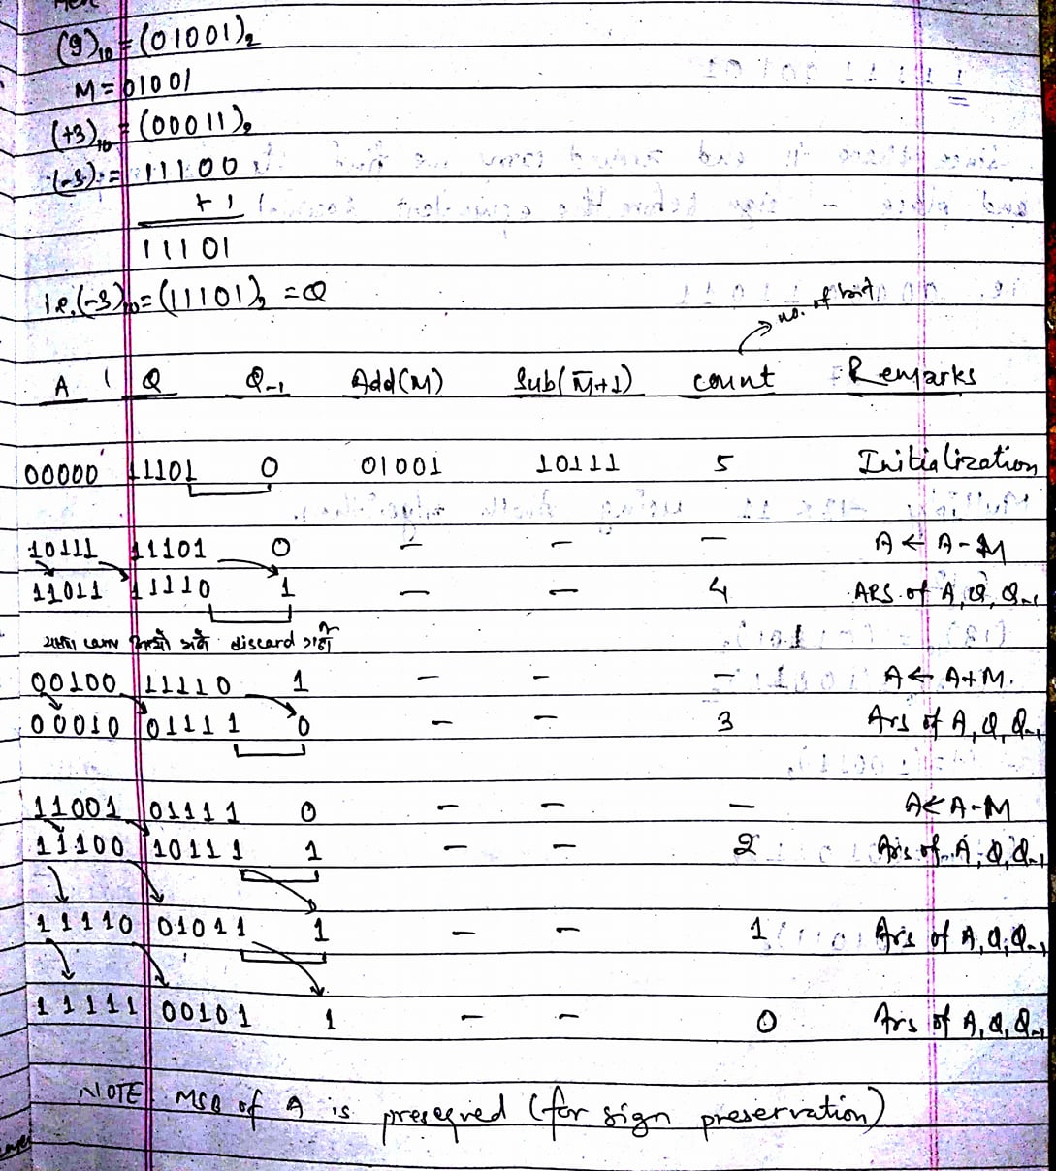
Multiply 9 x 3 using booth algorithm.

Slide 9
Contd…
Result Verification: 1 1 1 1 1 0 0 1 0 1 Since there is end around carry, we find it’s 2’s complement and place ‘-’ sign before the equivalent decimal. i.e. 0 0 0 0 0 1 1 0 1 1 i.e. -27

Slide 10
RTL code for Booth algorithm
1: U <- 0, Y₋₁ <- 0, I <- n Y₀Y₋₁’2: U <- U + X’ + 1 Y₀’Y₋₁2: U <- U + X 2: i <- i – 1 3: ashr(UV), cir(Y), Y₋₁ <- Y₀ Z’3: goto 2 Z3: FINISH <- 1

Slide 11
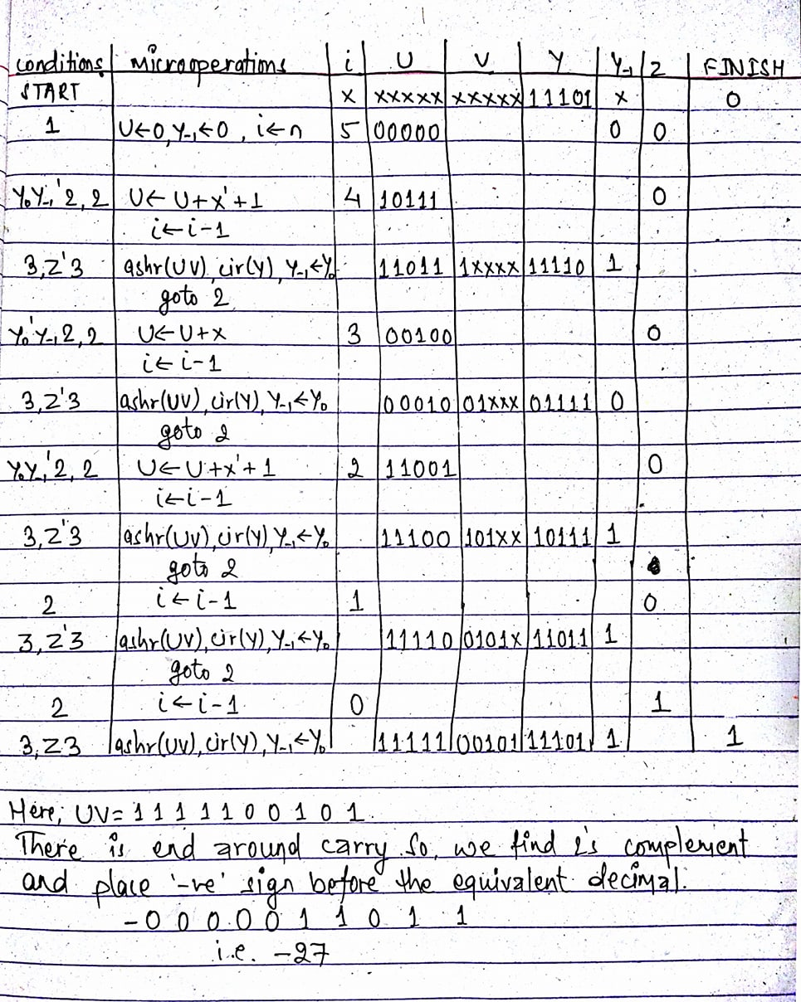
Perform 9 x -3 multiplication using Booth algorithm. Here, X = 9 = 01001 Y = -3= 11101

Slide 12
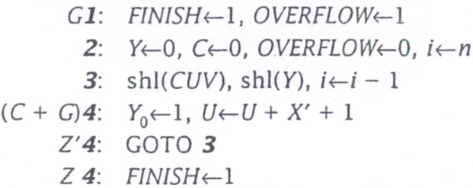
Shift subtract division (Before we look at the operation of the entire algorithm, consider the circumstances under which the first step terminates the algorithm. For 112÷7 with n=4, UV= 0111 0000 and X= 0111. Since, U≥X, the algorithm exists immediately. Had it proceeded, it should have produced a result of 16 (1 0000) and a remainder of 0. The value 1 0000 cannot be stored in a 4-bit register), this is the reason for the overflow.

Slide 13
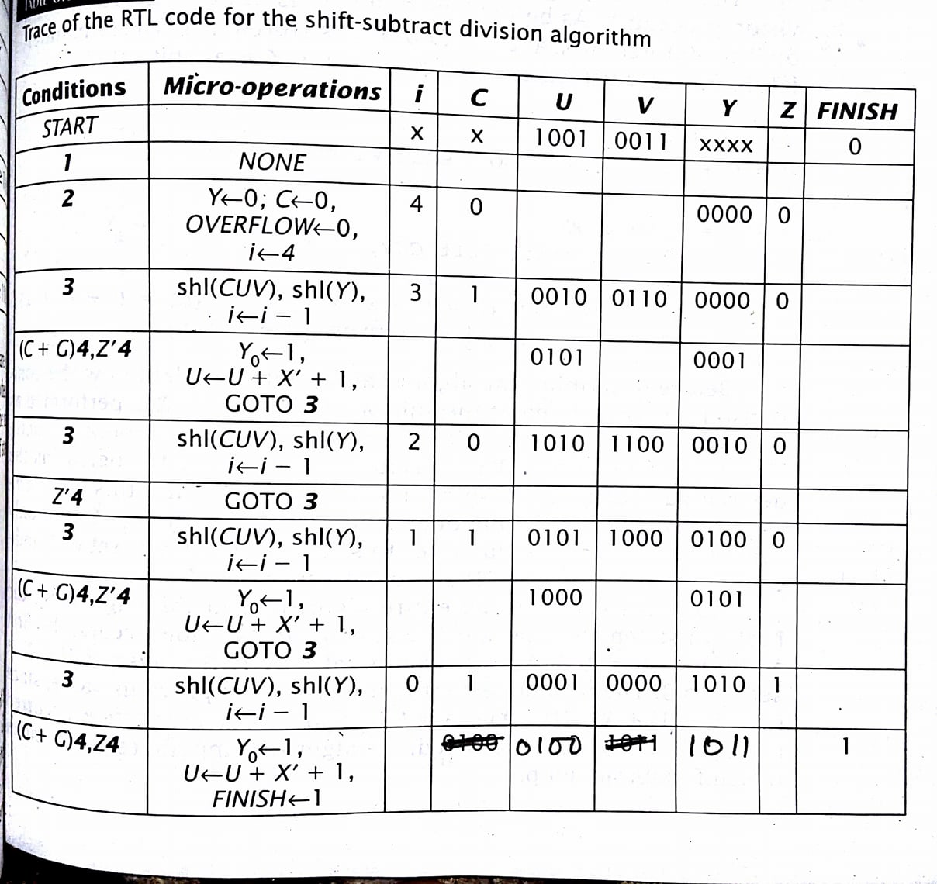
Contd… Trace of the RTL code for the operation 147 ÷ 13. Here, U = 1001, V = 0011, X = 1101 and n=4.

Slide 14
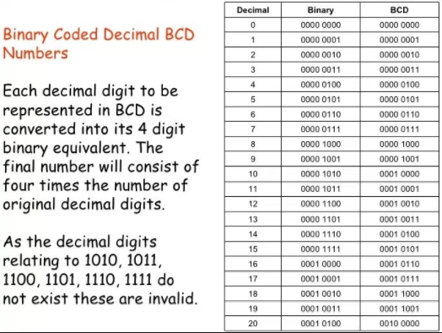
Binary Coded Decimal(BCD)

Slide 15
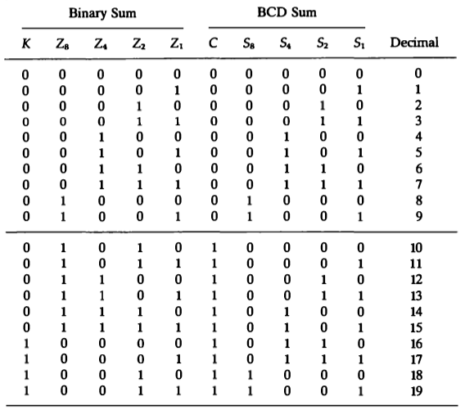
BCD adder: (When two decimal numbers are added, the maximum result is 19 => (9 + 9 +1(carry)))

Slide 16
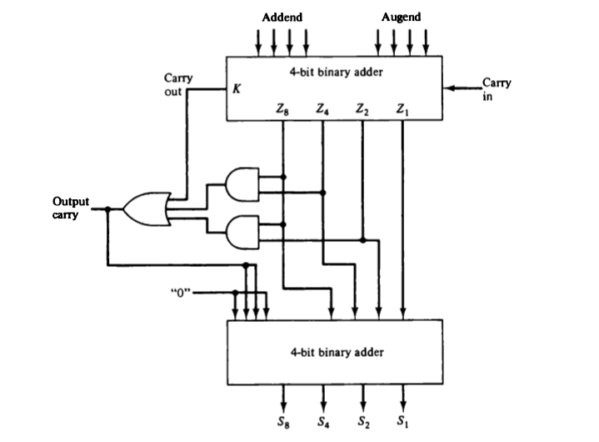
Contd… (The condition for the correction and setting c=1 is: c = k + z₈z₄ + z₈z₂ = 1)

Slide 17
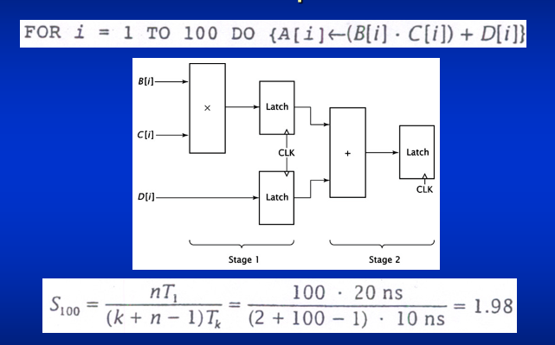
Specialized Arithmetic hardware 1. PIPELINING
T₁ = time taken by non-pipelined unit to calculate 1 result. Requires n.T₁ time to calculate n results. Pipelined unit requires k time units, each of duration T_{k} , to move the first piece of data through the pipeline. Because, additional data enters the pipeline during every cycle, it will output the remaining n-1 results during next n-1 cycles.
=> thus, the pipelined unit requires (k + n – 1) cycles, each of T_{k} time, to calculate same results. The speedup can be calculated by the formula above.

Slide 18
Contd…..
Data enters into a stage of the pipeline, which performs some arithmetic operations on those data.
The results are then passed to next stage which performs its operation and so on until the final computation ha been performed.
Each stage performs only its specific function, no need to be capable of performing the task of any other stage.
A pipeline does not speed up an individual computation. It improves the performance by overlapping computations where each stage can operate on different data simultaneously.
The net effect is that output appears more quickly than in non-pipeline arithmetic unit, thereby increasing the throughput.

Slide 19
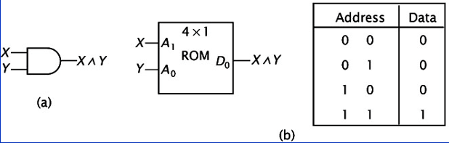
2. Lookup Tables:
Any combinational circuit can be implemented by ROM is a lookup table.
Inputs to the combinational circuit serve as the address input of the ROM.
Data outputs of the ROM corresponds to the output of the combinational circuit.
ROM is programmed with data such that the correct values are output for any possible input values.
Consider a 4 x 1 ROM programmed to mimic a two input AND gate.
By programming ROM with data shown, it outputs the same values as the AND gate for all possible values of X and Y.
AND gate
Lookup ROM equivalent

Slide 20
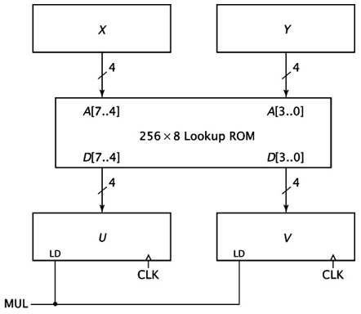
Contd..(a multiplier implemented using a lookup ROM)

Slide 21
Contd…
Registers X and Y supply the address inputs to lookup ROM.
It’s outputs are the product of X and Y, and are routed to registers U and V.
Each of 256 locations must contain the 8-bit product of X and Y.
For example, location 1011 1101 contains the data 1000 1111, 143, the product of 1011(11) and 1101(13).
Advantages: => the hardware may be less complex than that of the original shift-add implementation. => can multiply numbers more quickly than the shift-add hardware. => However, size of the lookup ROM grows rapidly as the size of the operands increases.

Slide 22
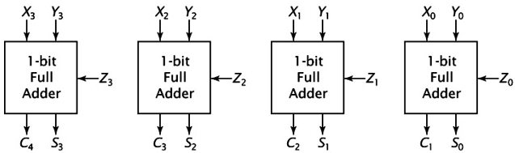
3. Wallace Tree
Combinational circuit used to multiply two numbers.
Instead of performing additions using standard parallel adder, Wallace tree uses carry save adder and only one parallel adder.
Carry save adder can add 3 values simultaneously. However, it does not output a single result, but provides both sum and a set of carry bits as output.
To form the final sum, S and C must be added together because carry bits do not propagate through the adder.

Slide 23
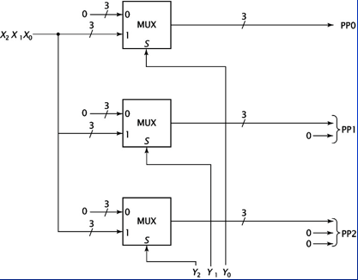
To use a carry save adder to perform multiplication, we first calculate the partial product of the multiplication and input them to carry save adder.
Fig: Generating partial products for multiplication using Wallace tree.

Slide 24
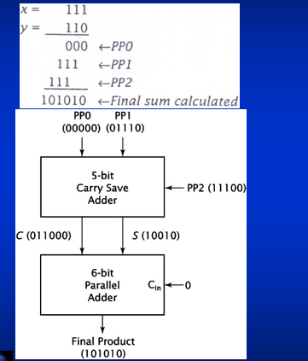
A 3 x 3 multiplier constructed using carry save adder.

Slide 25
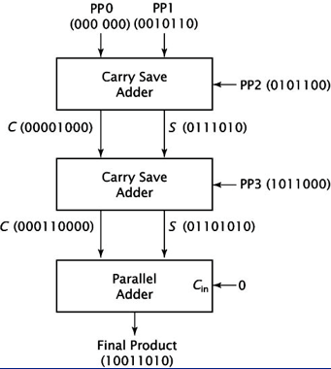
Contd.. A 4 x 4 Wallace tree multiplier.

Slide 26
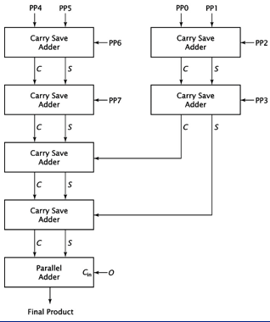
Contd… An 8 x 8 Wallace tree multiplier.

Slide 27
Floating point numbers
Floating point format is similar to scientific notation.
Using scientific notation, we can express a number in different ways. i.e. -1234.5678 = -1.2345678 x 10³ = -1234567.8 x 10⁻³
Computers can be efficient if each number can have only one representation (unique).
So, floating point numbers must be normalized i.e. each number significand is a fraction with no leading zeros.
Thus, the only valid floating point representation for this number is -.12345678 x 10⁴ The normalized representation works well for every possible numbers except 0
A computer stores floating point numbers in a pre-defined format. => Each number requires signed bit. => A significand of some pre-defined length. => An exponent of some given length. i.e.X_{S}X_{F}X_{E} where X_{S}=1, X_{F}=12345678 and X_{E}=4

Slide 28
Contd…
To represent negative exponents, one possibility is to use two’s complement values, the prevalent practice is to use biasing.
Assume that X_{E} has four bits, and should be able to represent all exponents from -8 to +7.
To do so, a set bias value is added to the actual exponent and result is stored in X_{E.}
-8 is represented as -8 + bias = -8 +8 = 0(0000).
+7 is represented as +7 + bias = +7 +8 = 15(1111).

Slide 29
IEEE 754 floating point standard
Defines set format and operation modes. Doesn’t specify arithmetic procedures and hardware to be used.
IEEE 754 standard is used in virtually all CPUs that have floating point capability.
IEEE 754 standard specifies two precisions for floating point numbers. 1. single precision number having 32 bits 2. double precision number having 64 bits
In single precision, 1 bit for sign, 8 bit for exponent & 23 bit for significand
In double precision, 1 bit for sign, 11 bit for exponent & 52 bit for significand
Significand falls in the range 1 ≤ significand < 2.
Exponent uses a bias of 127, having range -126 t0 127.
Exponent values 0000 0000(-127) and 1111 1111(128) are used for special numbers.

Slide 30
Contd…
+19.5 = 10011.1 or 1.00111 x 2⁴ in binary.
For +19.5 sign = 0 significand = 001 1100 0000 0000 0000 0000 exponent = 1000 0011 (131 = 4 + 127)
For 0 sign = 0 significand = 000 0000 0000 0000 0000 0000 exponent = 0000 0000
Not included, presence is implicit in this standard.

Slide 31
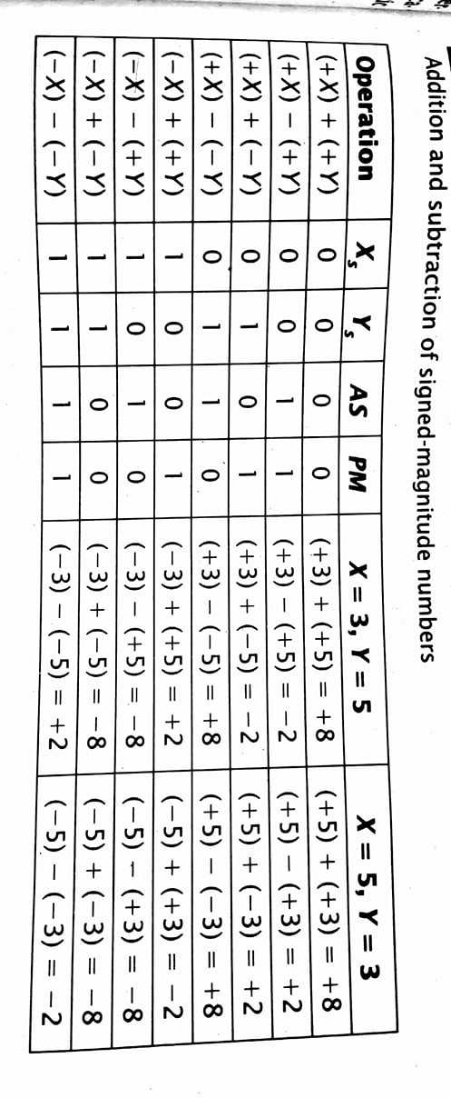
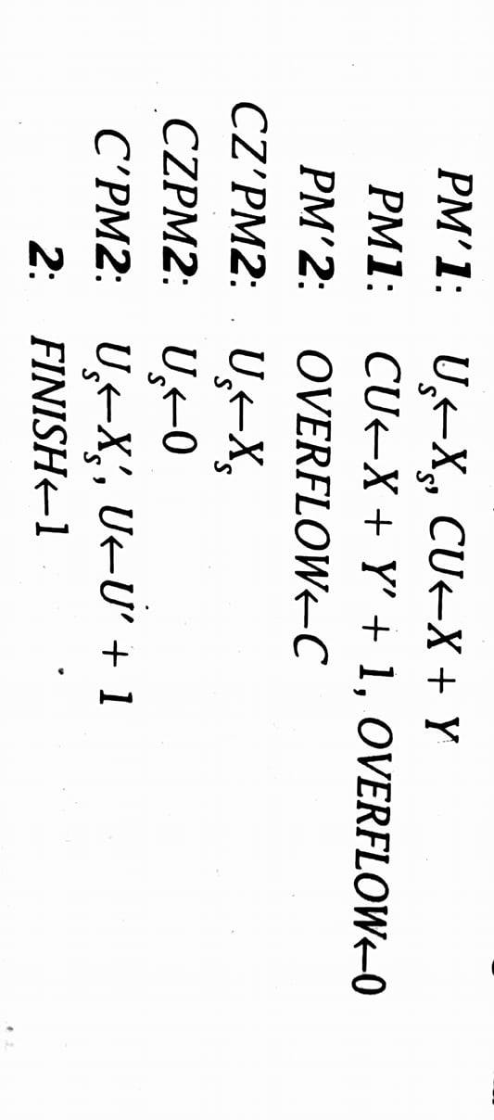
Addition and subtraction in Signed Notation

Slide 32
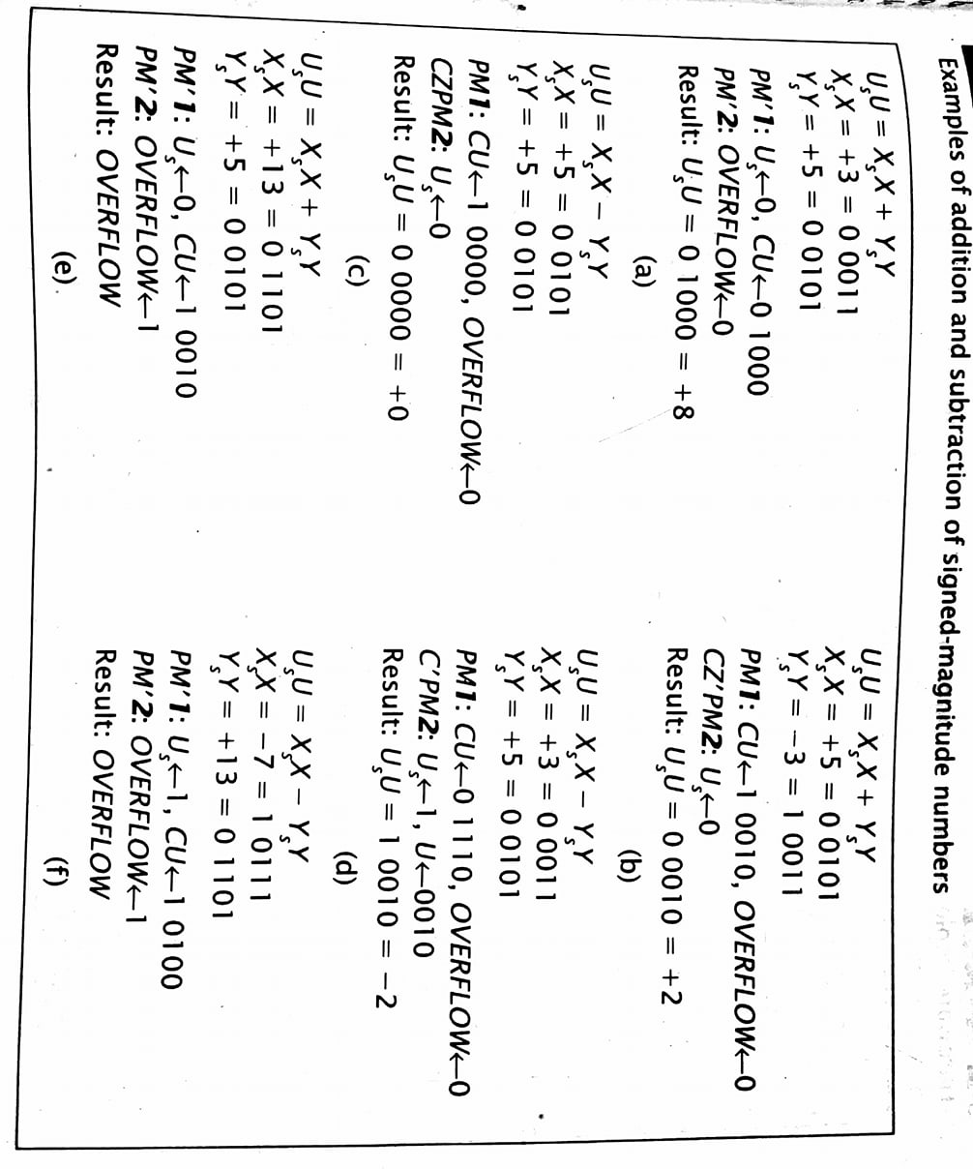
Contd…

